Slide 1
Software Engineering eDictionary – our experience with S-Bhan Tool
Asya Stoyanova-Doycheva
Plovdiv University

Slide 2
Our Task
The main goal of our work is to create an English-Bulgarian dictionary in Software engineering by S-Bahn-Tool.
Two students are working on this task as a diploma thesis – Maya and Ivan ☺
The work is organized in three stages
Getting knowledge about the S-Bahn –Tool and understanding the task;
Creating an English-Bulgarian dictionary – translation of the topics and different measurings;
Making an evaluation of the results.

Slide 3
Knowledge about S-Bhan Tool and Software Engineering (Resources)
Interactive Tool-based Production of Multilingual Teaching and Learning Materials, Klaus Bothe, Sam Joachim, Institute of Computer Science,Humboldt University Berlin, 10099 Berlin, Germany
USER MANUAL, S-Bahn Tool,Version 1.23 (19.01.2005), Sam Joachim
JCSE – Topics
Stoyanov, St., A. Stoyanova-Doycheva, M. Trendafilova, E. Doychev, “Software Technologies”, Plovdiv University Press, Plovdiv, 2006 (in Bulgarian)

Slide 4
Current state of the Bulgarian eDictionary in SE
Up to now we have translated 9 Topics
The eDictionary has 121 Bulgarian terms in SE

Slide 5
S-Bhan-tool Test Environment
Configuration of the PC
Fujitsu Siemens V3505
CPU: Intel T2050 1.6 GHZ
Ram: 1.5 GB
HDD: 60 GB
Operation System
Windows XP Professional SP3
MS Office 2003

Slide 6
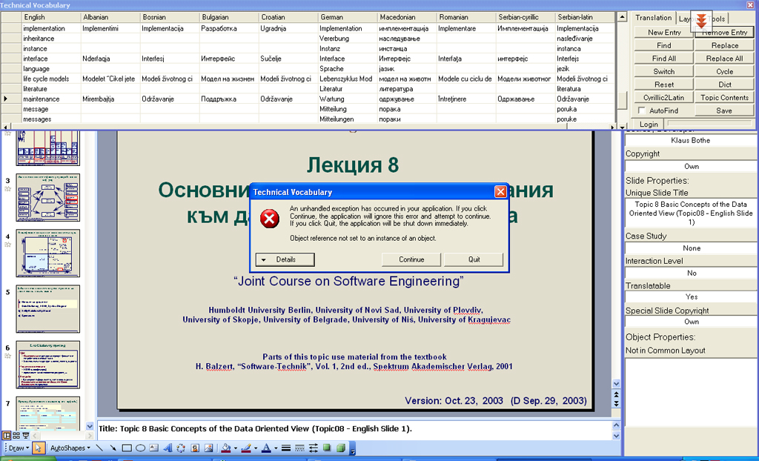
Problems with S-Bhan-tool (1/3)
When a term is deleted from the dictionary, the S-Bhan-tool raises an error and hangs.

Slide 7
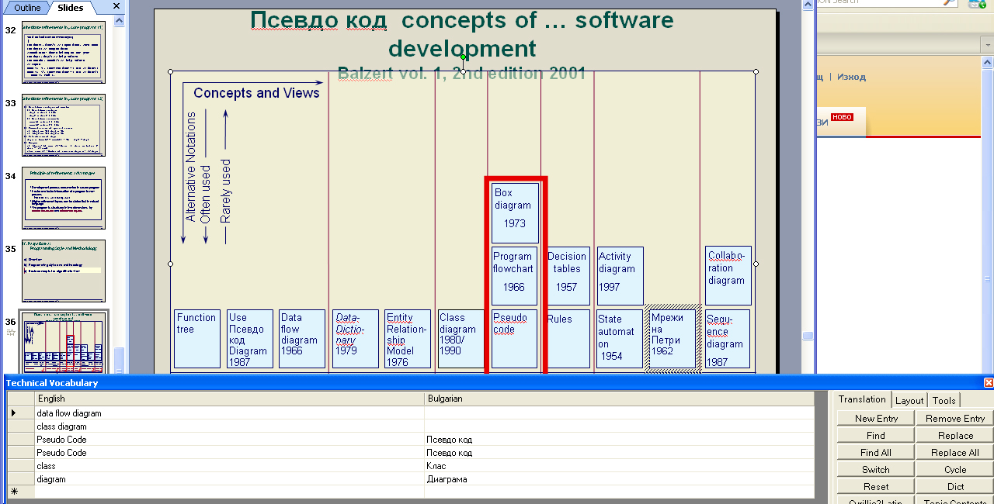
Problems with S-Bhan-tool (2/3)
The “replace” function sometimes does not work correctly – a term is not replaced, but it is present in the dictionary (for example “Pseudo code”).

Slide 8
Problems with S-Bhan-tool (3/3)
The “Replace All” function sometimes hangs the application. The conditions are not stable and for this reason we do not have a screenshot.

Slide 9
Statistic – translation time table
Topic | Student | Time | Dictionary
 |  |  | Before | After
Topic 1 | Maya | 03:41 | 0 | 19
 | Ivan | 00:20 | 19 | 20
Topic 2 | Maya | 01:00 | 20 | 27
 | Ivan | 01:15 | 27 | 41
Topic 3 | Ivan | 02:40 | 41 | 66
 | Maya | 00:50 | 66 | 72
Topic 4 | Maya | 01:38 | 72 | 87
 | Ivan | 00:25 | 87 | 89
Topic 5 | Maya | 06:09 | 89 | 96
 | Ivan | 00:20 | 96 | 96
Topic 6 | Ivan | 03:05 | 96 | 108
 | Maya | 00:10 | 108 | 108
Topic 7 | Maya | 03:30 | 108 | 112
 | Ivan | 00:15 | 112 | 112
Topic 8 | Ivan | 01:20 | 112 | 121
 | Maya | 00:15 | 121 | 121
Topic 9 | Ivan | 01:20 | 121 | 121
 | Maya | 00:10 | 121 | 121

